Slide 1
Fall Detection System for Elderly - Detects sudden falls and sends alerts
GROUP 19
SACKEY, Vladimir Kwesi
SAHYOUN, Caroline
VOWOTOR, Brian Selorm Kobla Fui
OFOSU, Yeboah Desmond
OMAN, Madalene Kaki
OHIPENI, Annabelle Padiki
DERY, Kuusofaa David
OFORI, David
OFORI, Emmanuel Lartey Mawu Leley
OGILO, Ernest Emuseri Yaw

Slide 2
Contents
Part 01
Part 02
Part 03
Part 04
Overview
Hardware Setup
Software Implementation
Demonstration
Part 05
Future improvements

Slide 3
Overview
01

Slide 4

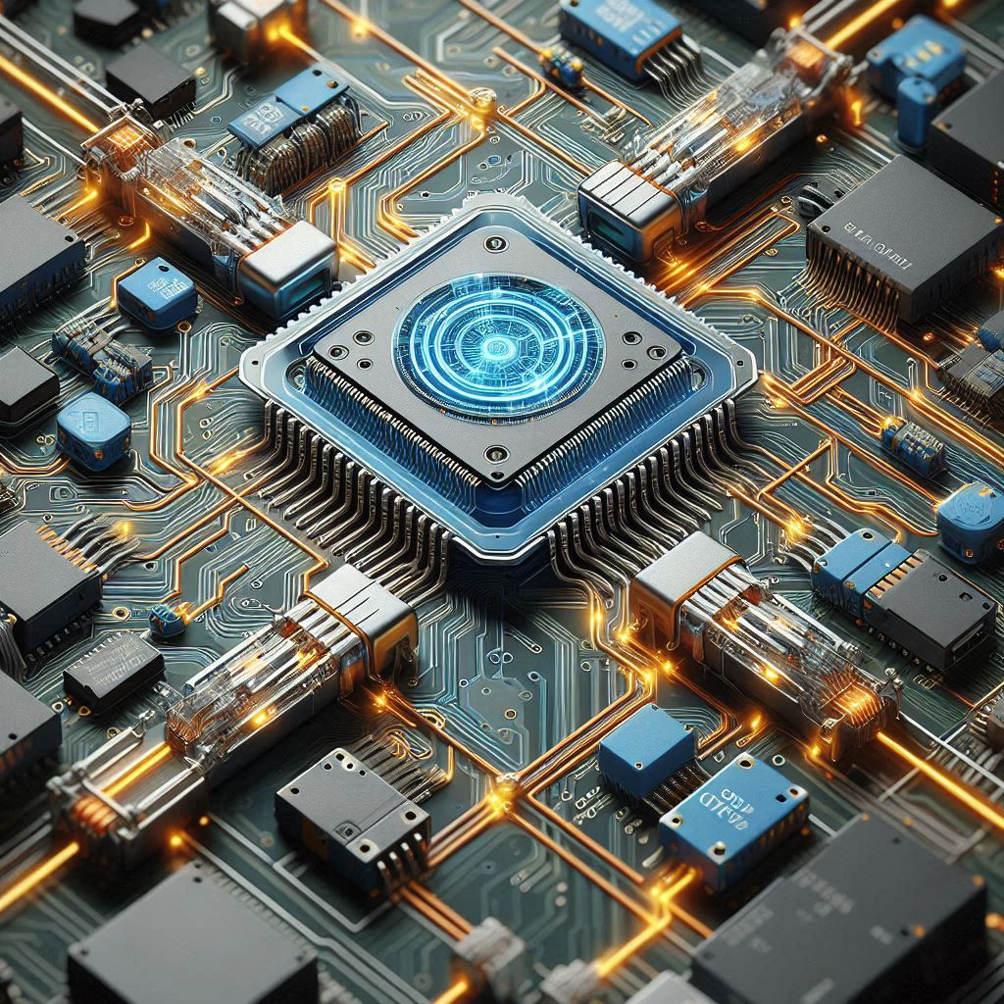

Project Description
Fall Detection
Simulation
IoT Integration
It is fall detection program for the elderly that sends alerts to a caregiver
Simulated on Wokwi using ESP32 and MPU6050 sensors with an led and a resistor
Uses Blynk IoT to send alerts anytime a fall is confirmed

Slide 5
Hardware Setup
02

Slide 6
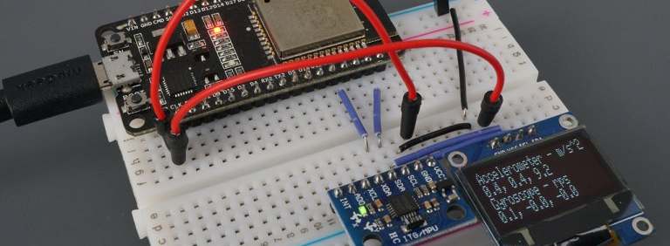
Components
01
ESP32
02
MPU6050
03
Buzzer
04
LED
Microcontroller board
Gyroscope and accelerometer sensor
Audible alert
Visual alert

Slide 7
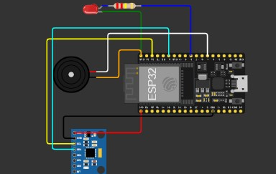
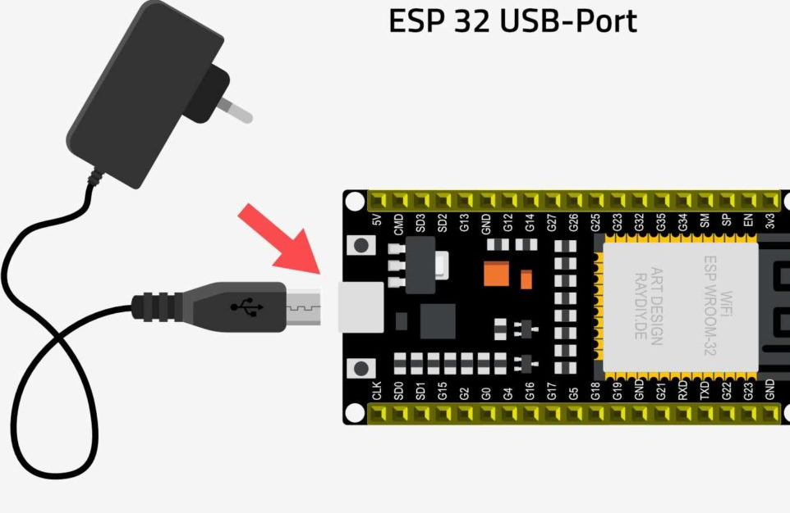
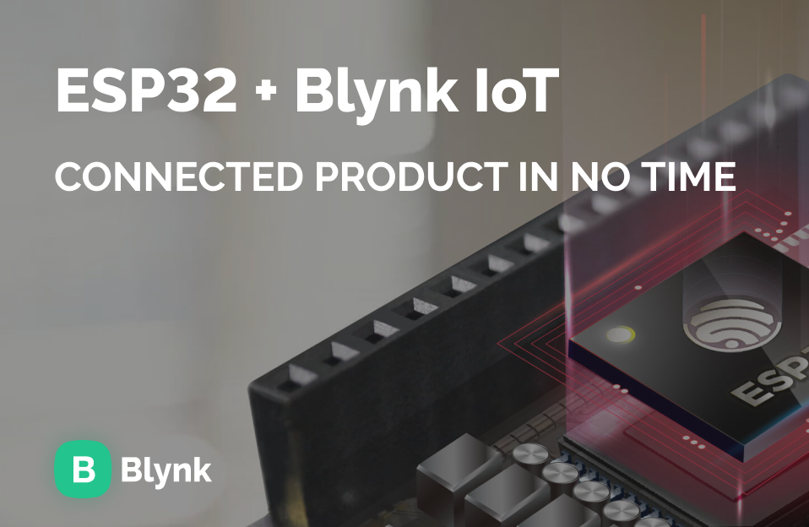
Wiring
01
02
03
Connections
Power Supply
Communication
ESP32 connected to MPU6050, buzzer, and LED
Powered by USB or battery
I2C(Inter-Integrated Circuit) for MPU6050, WiFi for Blynk

Slide 8
Software Implementation
03

Slide 9

Fall Detection Algorithm
Free Fall
Impact Detection
Stillness Check
Detect free fall using low acceleration and gyro values or recorded magnitude
Detect impact using high acceleration and gyro values
Confirm fall by checking for lack of movement using set thresholds in the code

Slide 10
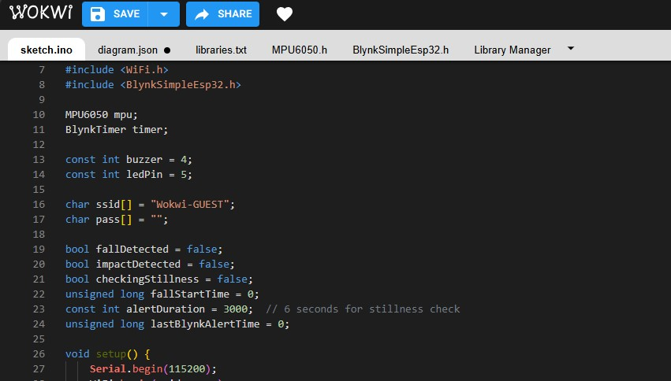

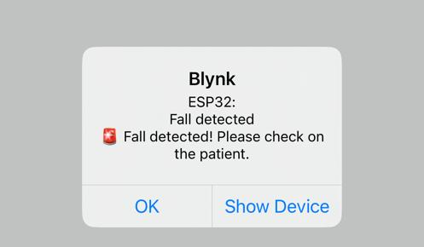


Blynk Integration
WiFi Connection
Blynk Setup
Alert Notification
Connect to WiFi network
Connect to Blynk IoT platform using authentication token generated for the specific ESP 32
A fall detection alert is sent to caregiver via Blynk

Slide 11
Demonstration
04

Slide 12
Test Cases
Free Fall
Simulate free fall and check for impact detection
False Alarm
Simulate movement after impact and check for false alarm to ensure that only genuine falls are sent to caregiver
Successful Alert
If a fall is detected an alert is sent to the caregiver, a buzzer is triggered and the led light turns on.

Slide 13
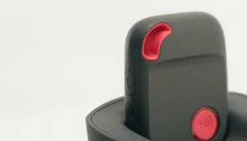
Results
Accuracy
Responsiveness
Practical Application
Reliable fall detection with minimal false positives
Prompt alert notification to caregiver in real time
Suitable for elderly fall monitoring in home environments

Slide 14
FUTURE IMPROVEMENTS
05

Slide 15
Future improvements
Machine learning models to learn user (elderly person’s ) patterns in movement to ensure accurate fall detection.
Connectivity with GPS systems to aid in location tracking in the event of a fall and stillness.
Serialization of the fall detection system for each elderly person to enable multi-user interfacing and multiple fall detection.
Manual override button or switch on device to override accidental buzzer and LED alerts when there is a false alarm.

Slide 16
Thank You
GROUP 19

